Slide 1
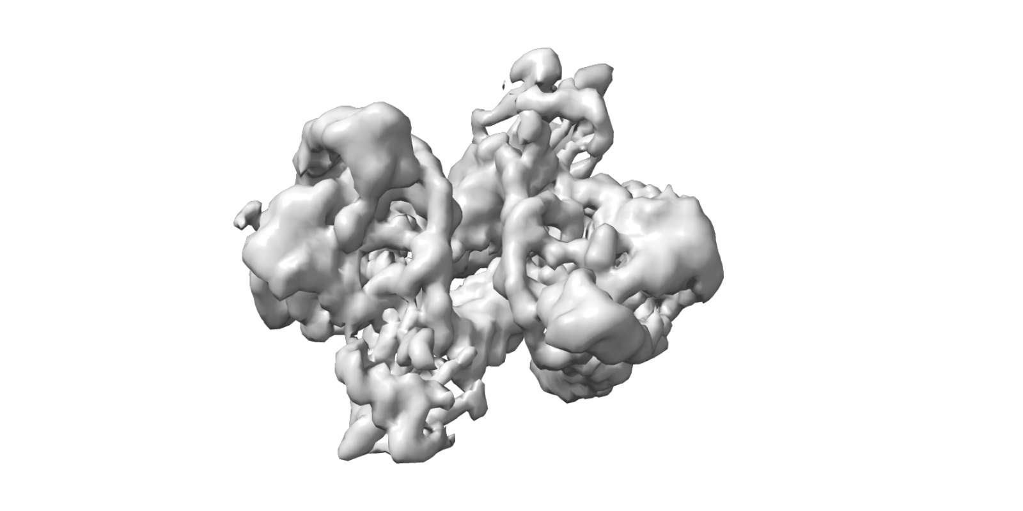
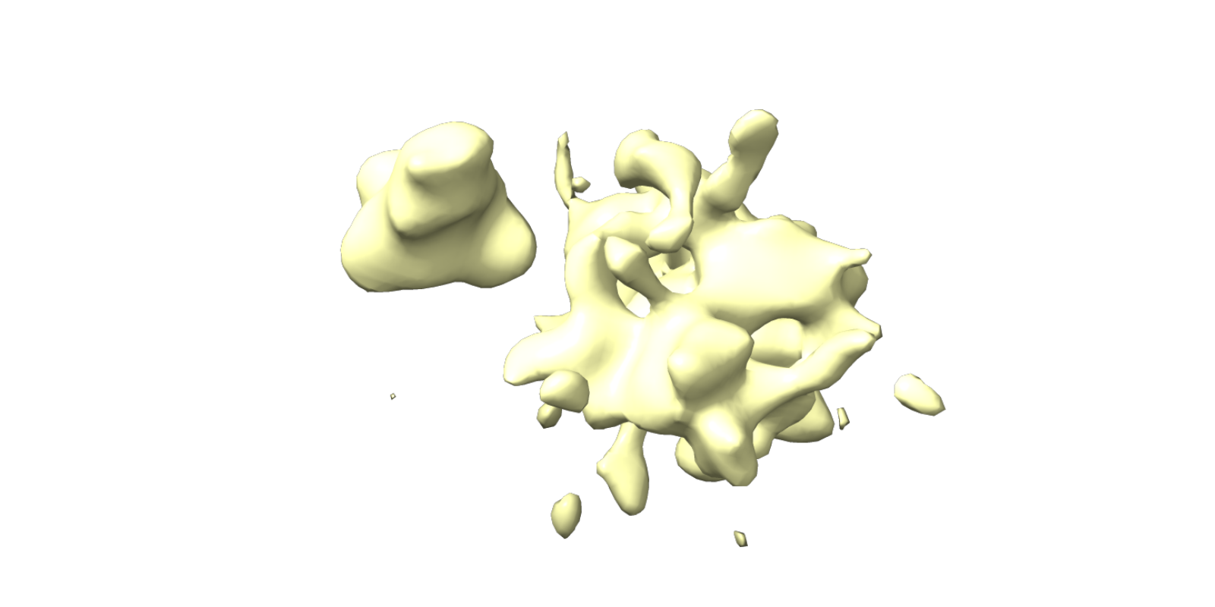
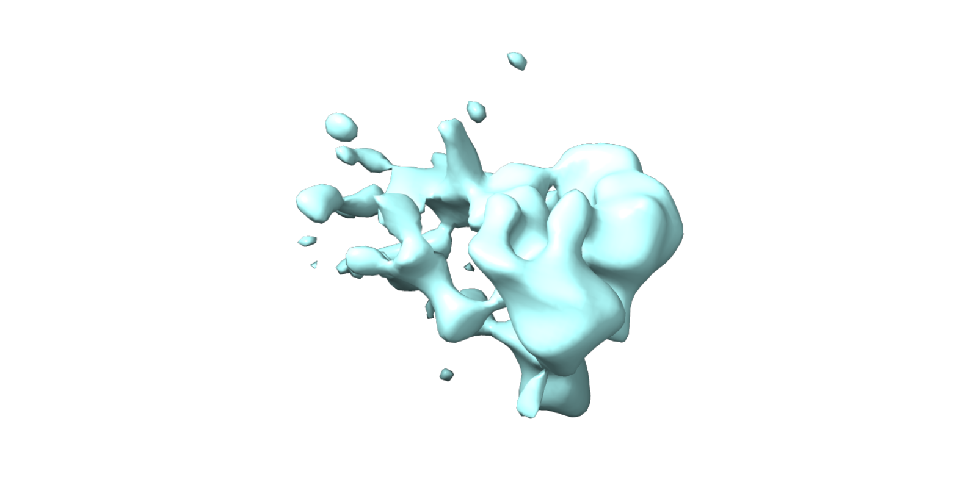
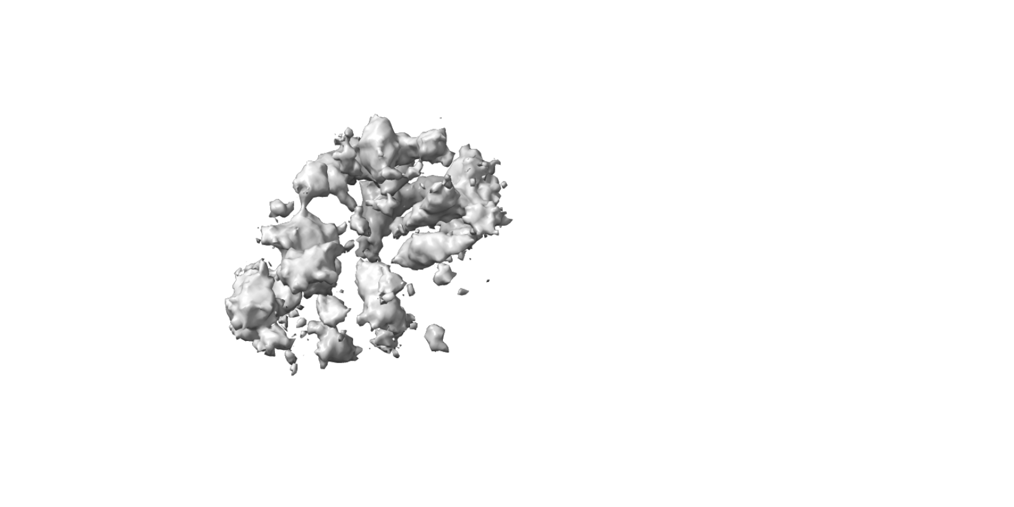
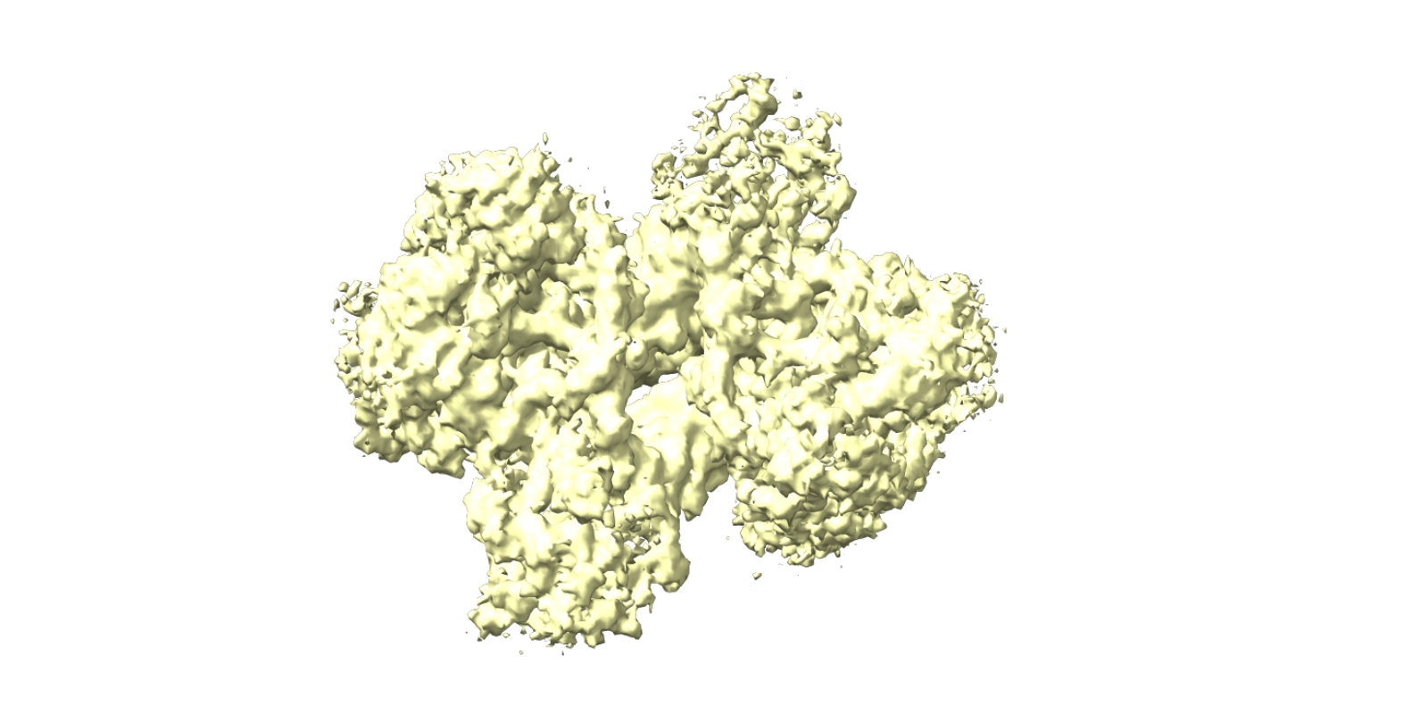
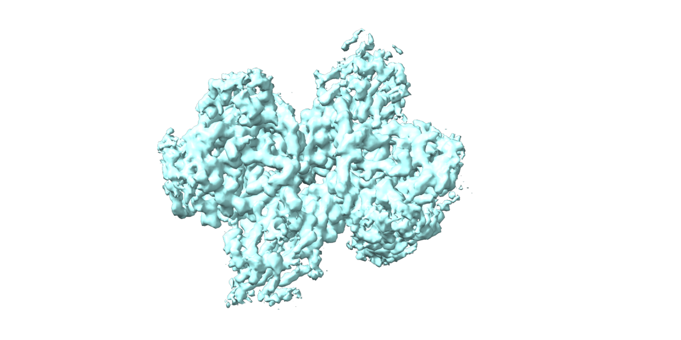
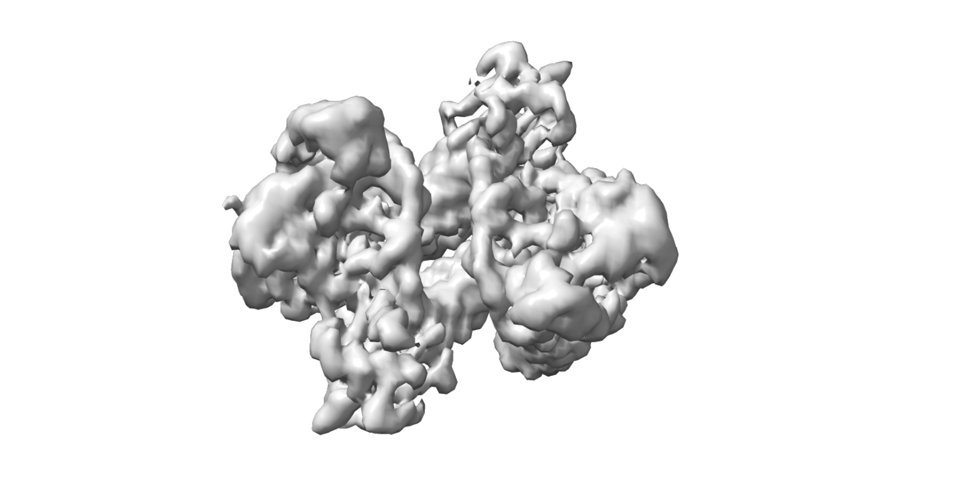
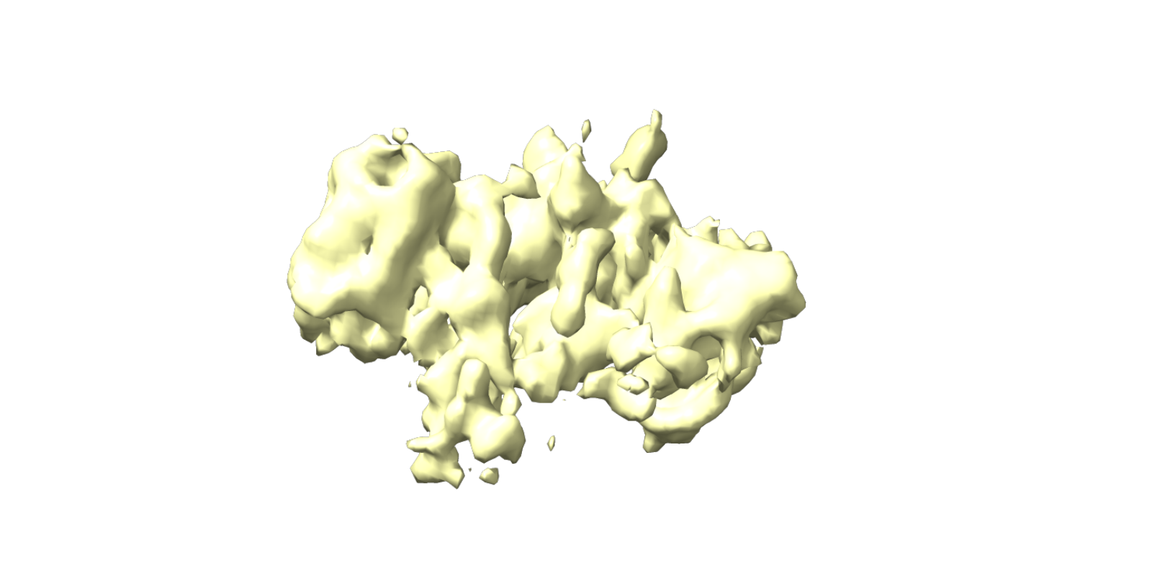
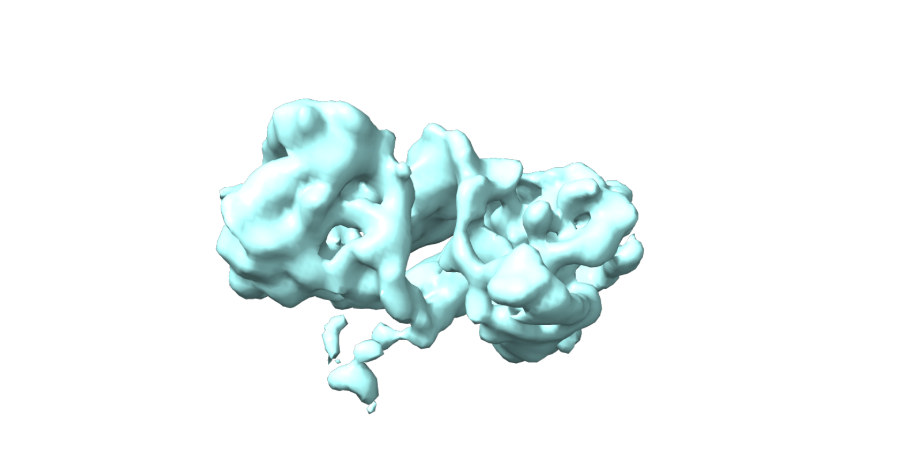
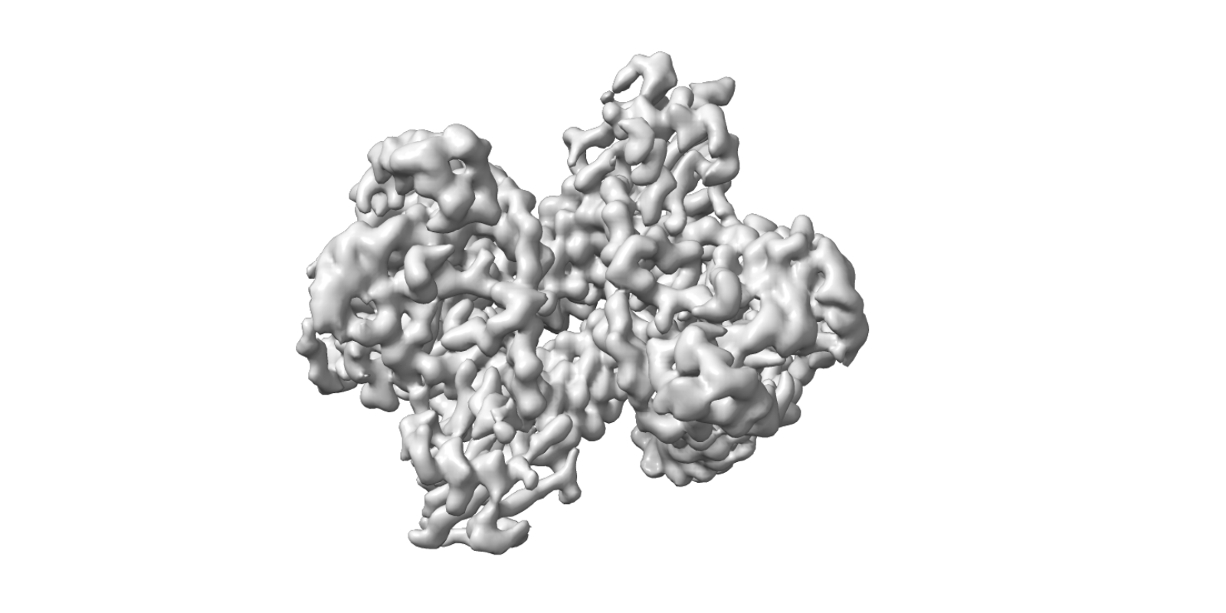
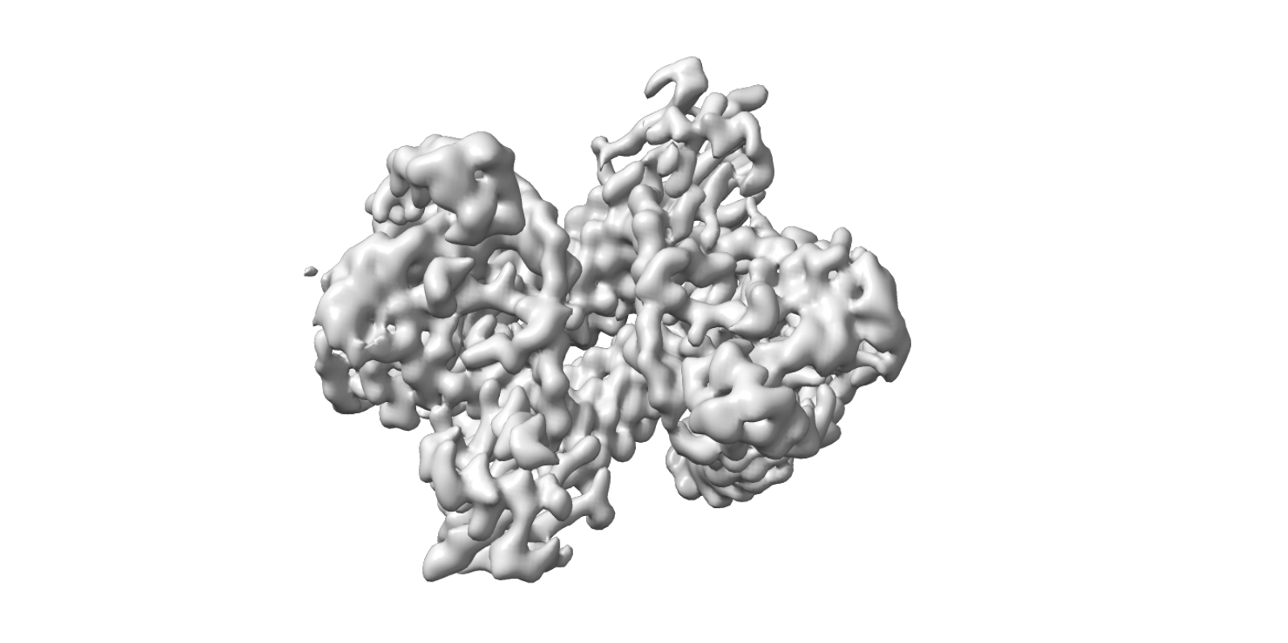

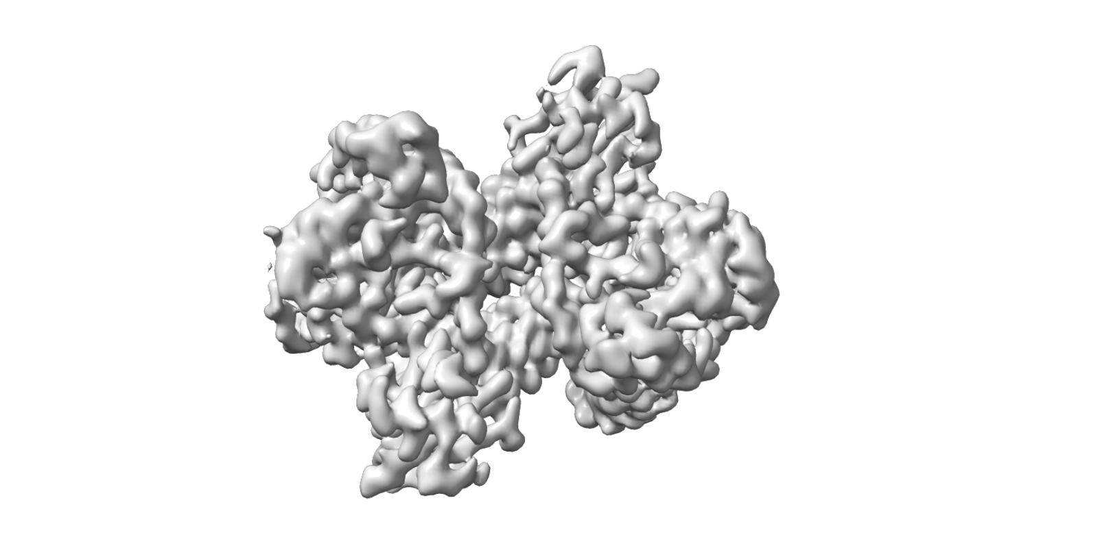
6,060 Micrographs
Auto pick
1635K particles
Hetero refinement · J31
Ab-initio reconstruction · J39
77%
590,421 particles
11.8%
90,557 particles
11.2%
85,582 particles
4.2%
15,755 particles
40.6%
153,795 particles
55.2%
209,127 particles
Hetero refinement · J34
Homo Reconstruct · J40
209,127 particles
64.1%
378,677 particles
18.6%
109,606 particles
17.3%
102,138 particles
Non-uniform refinement · J35
Local refinement · J41
378,677 particles
209,127 particles
Non-uniform refinement · J37
378,677 particles
所有地图已对齐至参考 J41/volume · 手性检查: 3 个已翻正，10 个一致 · 视角 y-90 · CryoSmart Workflow Figure (ChimeraX aligned)

